Slide 1

Transfer Learning
Qing(Leah) Li
Supervised by Dr. Quan Long
Cumming School of Medicine
University of Calgary

Slide 2
Outlines
Part I:
1. What is transfer learning?
2. Rationality for transfer learning
3. Transfer learning examples
3.1 Image classification
3.2 DTL: Disease-specific variants detections (Leah’s research project)
Part II:
4. Deep learning basic glossary
5. Hands-on: Image classification
Google colab

Slide 3
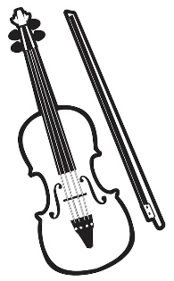




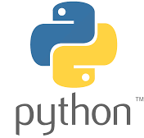
1. What is transfer learning?
Everyone does transfer learning since very little
Transfer learning focuses on storing knowledge gained while solving one problem and applying it to a different but related problem [wiki]

Slide 4
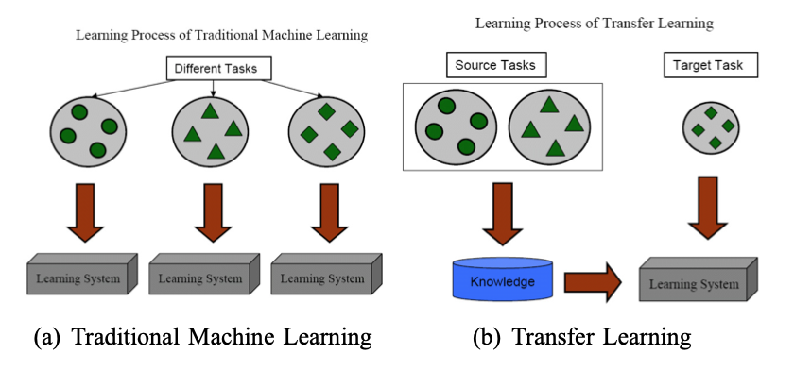
2. Rationality for transfer learning
Advantages:
Some pre-trained models (giants)
Are proven to be successful and valuable
Large-scale architectures
Trained on large datasets (like ImageNet)
Are refined many times
Are trained with many GPU resources
Transfer learning (standing on the shoulders of giants)
Transfer the success (or knowledge) from pre-trained models
Less errors adjusting architecture
Training is easier and faster
Image source: Pan & Yang, IEEE Trans Knowledge & Data Engineering 2009

Slide 5
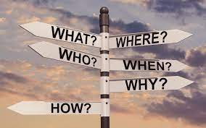
3. Transfer learning examples
3.1 Image classification
3.2 DTL: Disease-specific variants detections (Leah’s research project)

Slide 6
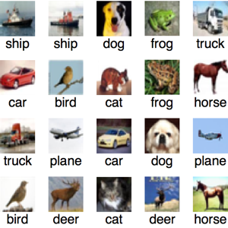
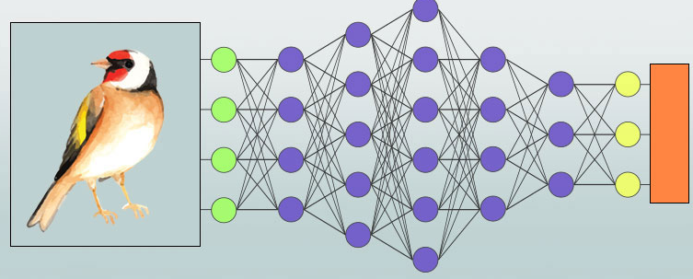
3.1 Image classification
A very conventional task
Traditional machine learning:
Train from scratch
Image sources: https://www.educba.com/tensorflow-image-classification/

Slide 7

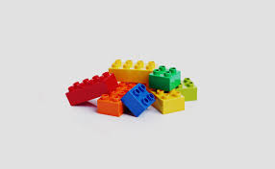
3.1 Image classification
Modern transfer learning:
Convolutional neural network,
Using a pre-trained model to solve a new similar problem
CAT
DOG
Images
Conv
Pooling
BN
Flatten
Dense
FNN
CAR
BIRD
Conv
Pooling
BN
FNN
Image sources: https://www.educba.com/tensorflow-image-classification/

Slide 8
3.1 Image classification
Tips for a successful transfer learning
Choose an appropriate pre-trained model
Type of the application (image-based, text-based, …)
Scale of the pre-trained model
Compatibility at both the input and output ends of the base model
Shape
Data type
Where to get pre-trained models?
Pre-trained models from other’s (https://github.com/)
Tensorflow Hub (previously Model Zoo) pre-trained models, (https://tfhub.dev/)
Notes:
GitHub is a web-based interface that uses Git, the open source version control software that lets multiple people make separate changes to web pages at the same time.
TensorFlow Hub is a repository of trained machine learning models ready for fine-tuning and deployable anywhere.

Slide 9
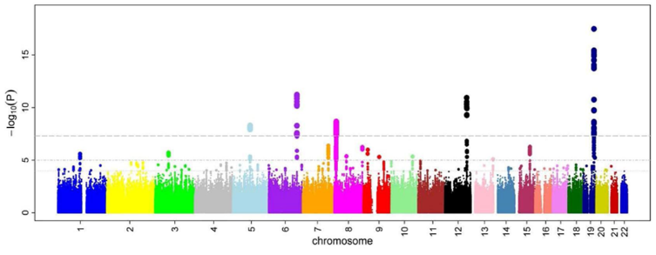
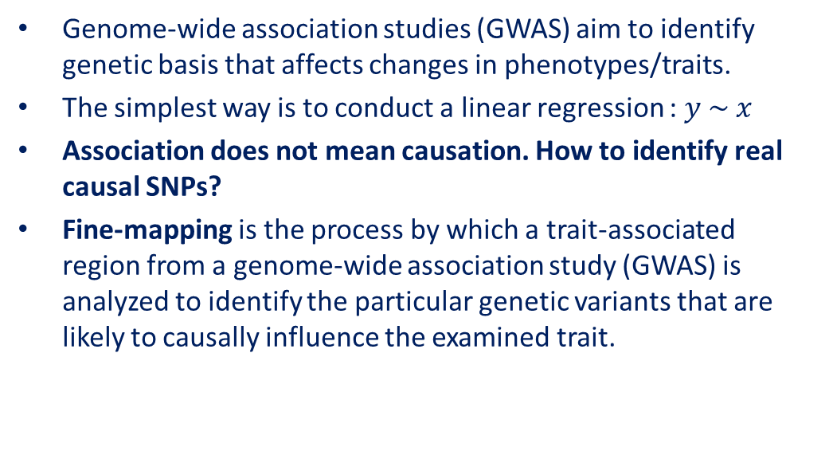
3.2 DTL: Disease-specific variants detections
Genome-wide association studies (GWAS) aim to identify genetic basis that affects changes in phenotypes/traits.
The simplest way is to conduct a linear regression : $y \sim x$
Association does not mean causation. How to identify real causal SNPs?
Fine-mapping is the process by which a trait-associated region from a genome-wide association study (GWAS) is analyzed to identify the particular genetic variants that are likely to causally influence the examined trait.
Notes:
Stringent

Slide 10
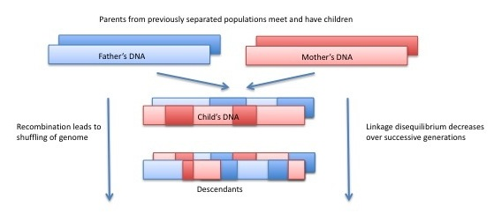
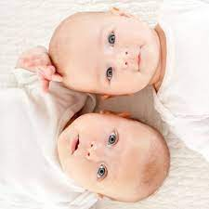
3.2 DTL: Disease-specific variants detections
Why is it hard to determine which one is causal?
linkage disequilibrium (LD) is the non-random association of alleles at different loci in a given population.
Notes:
Obstacle
During meiosis, mother chromosomes will have some recombination.
And the same for father chromosomes.

Slide 11
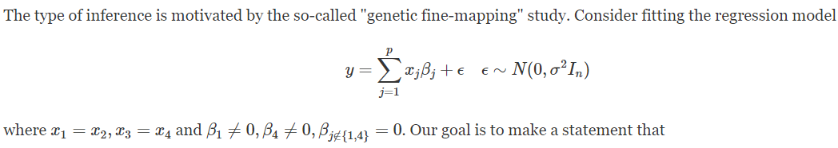
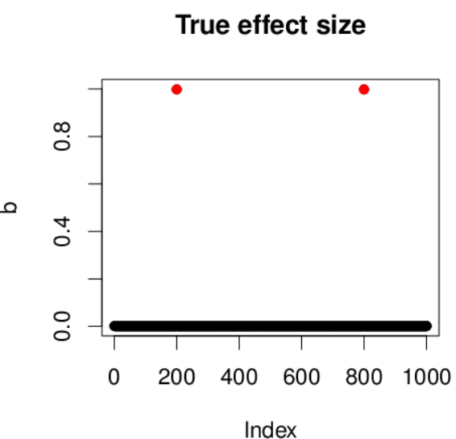
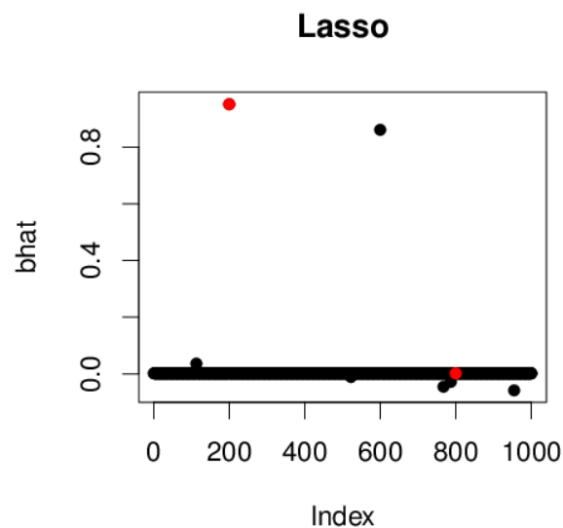
3.2 DTL: Disease-specific variants detections
X1 X4
X1 X3
X1 X3
X2 X3
X2 X4
How about a group containing a causal SNP?
{1,2}, {3,4}
Notes:
Let’s look at this problem from a mathematical view.

Slide 12
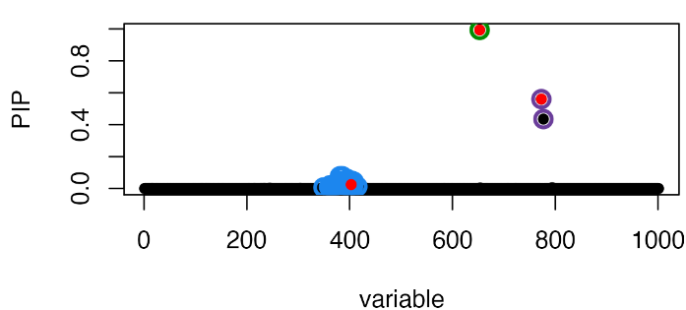
3.2 DTL: Disease-specific variants detections
Smart idea: Credible Sets
Definition: A 95% Credible Sets (CS) of variables is a set that has > 95% probability of containing at least one non-zero effect size
Hope to report as many CSs as possible, each as small as possible.
SuSiE: Sum of Single Effects.
Input: individual genotype or GWAS summary statistics
Output: a number of “Credible Sets” (CSs), which highly likely contain a variable with non-zero effects, meanwhile being as small as possible. PIP: posterior inclusion probability
Notes:
You can think of the CSs as being a set of “highly correlated” variables that are each associated with the response: you can be confident that one of the variables has a non-zero coefficient, but they are too correlated to be sure which one.

Slide 13
3.2 DTL: Disease-specific variants detections
Limitation of SuSiE: it gives the same prior probability to all SNPs
Nonsynonymous mutations >> synonymous
Coding region mutations > noncoding regions mutations
Polyfun: weight SNPs by their functional biological annotations
Input: hundreds/thousands of functional biological annotations
Output: per-SNP heritability, which can be regarded as the prior causal probability
Coding
Intron
Conserved
Coding
Intron
Conserved
-log10(p)
-log10(p)

Slide 14
3.2 DTL: Disease-specific variants detections
Goal: weight SNPs by their disease-specific functional biological annotations to identify more causal genetic variants affecting risk of human cancers.
Approach: develop novel models through Deep Transfer Learning (DTL)
Notes:
What kind of role can transfer learning play here?

Slide 15

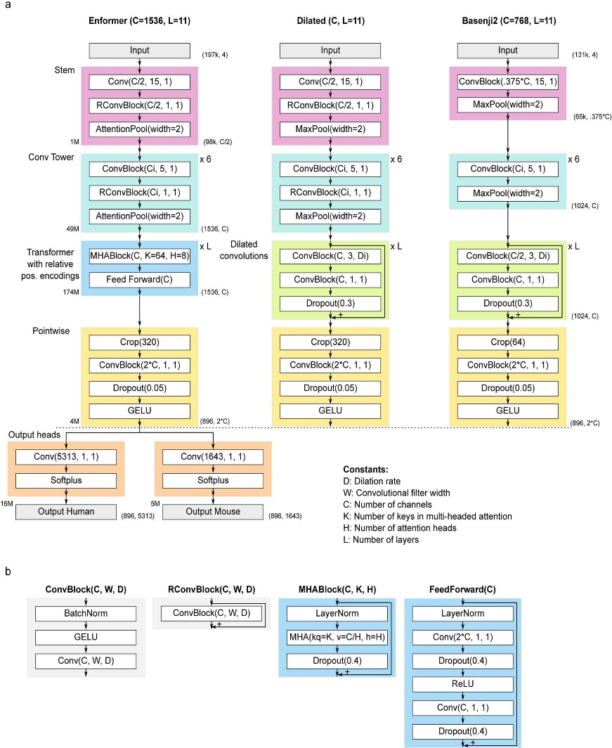
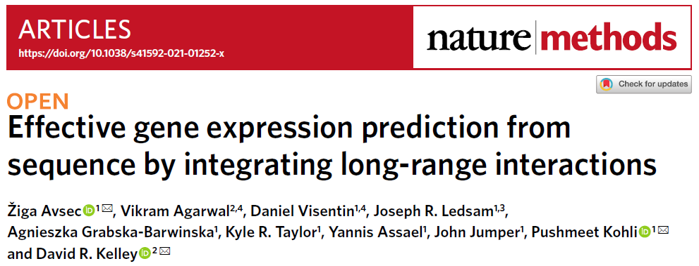
3.2 DTL: Disease-specific variants detections
Enformer
Standing on the shoulders of giants
Wow, giants!
Enformer outputs tracks :
5,313 human genomic tracks (638 CAGE, 684 DNase/ATAC, and 3991 ChIP datasets)
1,643 mouse genomic tracks (357 CAGE, 228 DNase/ATAC, and 1058 ChIP datasets)
Enformer inputs DNA sequences:
Human genomes: 38,171 (34,021 training, 2,213 validation, and 1,937 test) sequences
Mouse genomes: 33,521 (29,295 training, 2,209 validation, and 2,017 test) sequences

Slide 16
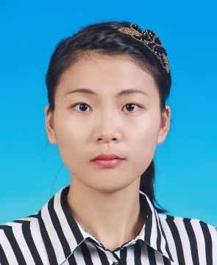
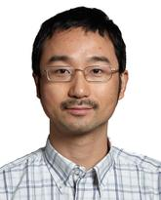
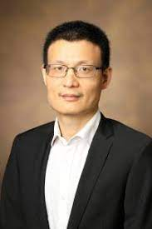

3.2 DTL: Disease-specific variants detections
Qing (Leah) Li
Quan Long
Xingyi Guo
Enformer
TFEnformer
Conv(275,1,1)
Softplus
Output Human
Notes:
I borrowed … I cut out the mouse output head and only keep human output head as my research study focus on detecting causal human genetic variants. I also adapted the shape for outputs to fit my target epigenetic data.

Slide 17
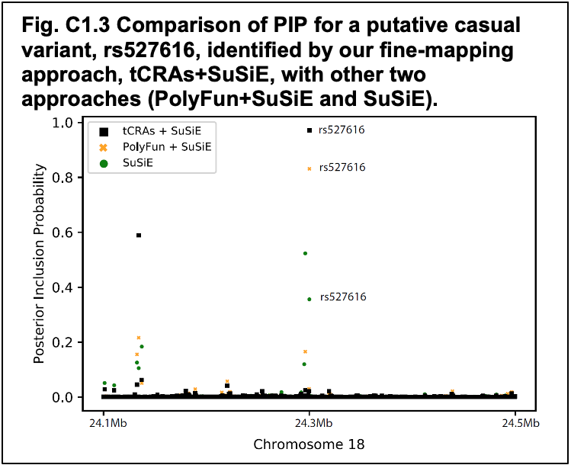
3.2 DTL: Disease-specific variants detections

Slide 18
3.2 DTL: Disease-specific variants detections
Take away messages:
Functional biological annotations are important in discovering causal disease variants
However, disease-specific functional annotations were not integrated in previous models
Using transfer learning can fill up these gaps, thus promoting discoveries of disease-specific causal variants.

Slide 19
4. Deep learning basic glossary
Models’ architectures
Dataset
Model training
Hyperparameters
Parameters
Epoch
Batch sizes
Iterations
Loss function
Feed forward and backpropagation
Gradient descent (Adam, SGD)
Learning rate
Model evaluation

Slide 20

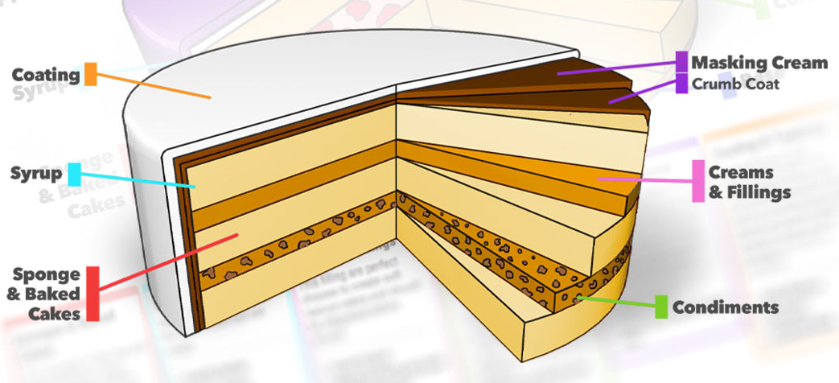
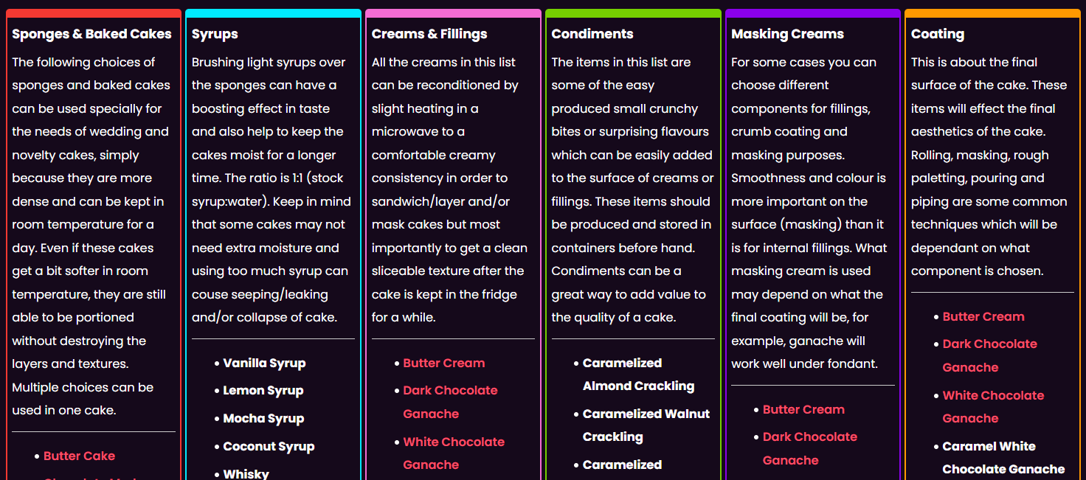
4.1 Models’ architectures
https://www.yenersway.com/resources/combination-guide-for-layered-cakes/

Slide 21
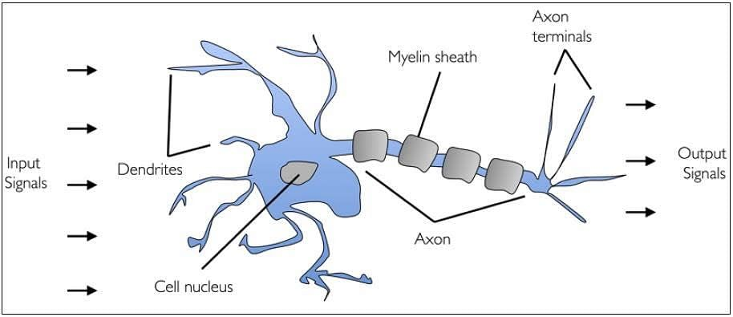
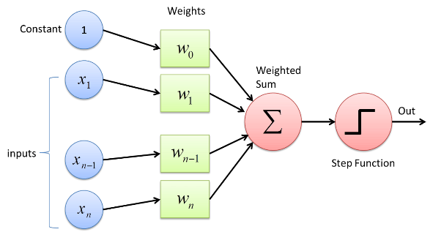
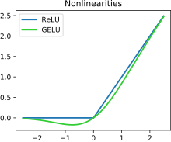
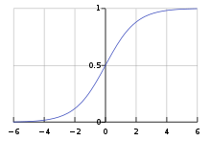
4.1 Models’ architectures
Model
Functional blocks
Layers (neural network)
Fully connected
Sparsely connected (dropout)
Convolutional layers
Activation function (add nonlinearity to NN)
Input and output shape
Perceptron
https://towardsdatascience.com/what-the-hell-is-perceptron-626217814f53; https://arxiv.org/pdf/1809.05165.pdf; https://www.simplilearn.com/tutorials/deep-learning-tutorial/perceptron; https://en.wikipedia.org/wiki/Activation_function
Notes:
Mimic a real biological neuron.
A lot of dendrite accept stimulates, cell nuclei deals with these stimulates and to be activated or not activated. If it’s activated, information will pass by axon.
Scientists developed
anatomy

Slide 22
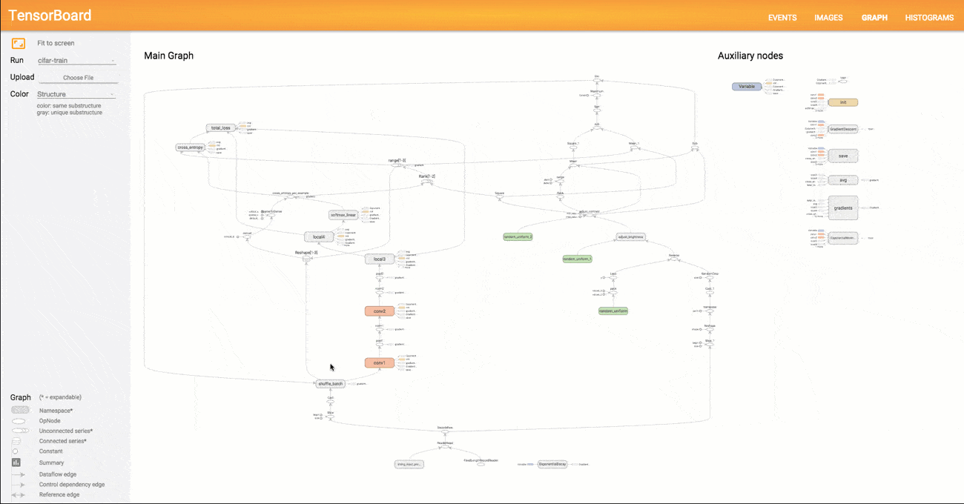
4.1 Models’ architectures
Visualization: TensorBoard, WANDB, etc.
https://towardsdatascience.com/tensorboard-visualizing-learning-ad1b6667585

Slide 23




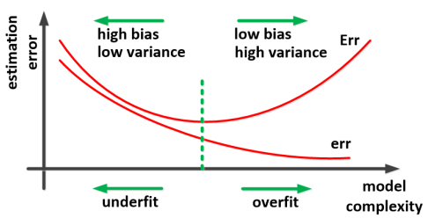
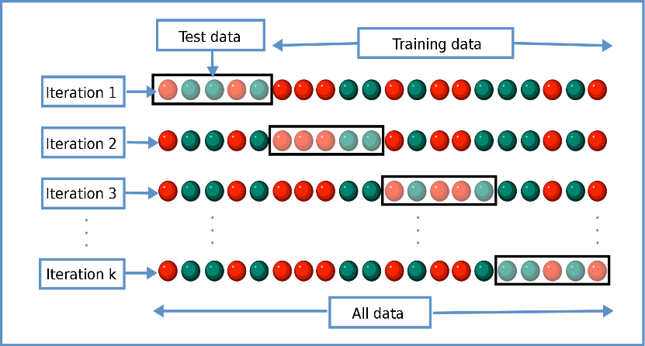
4.2 Datasets
Train dataset
Test dataset
Train models’ parameters on train datasets and measure models’ performance on the test datasets
Ghojogh et al, arXiv 2019, https://en.wikipedia.org/wiki/Cross-validation_(statistics)

Slide 24

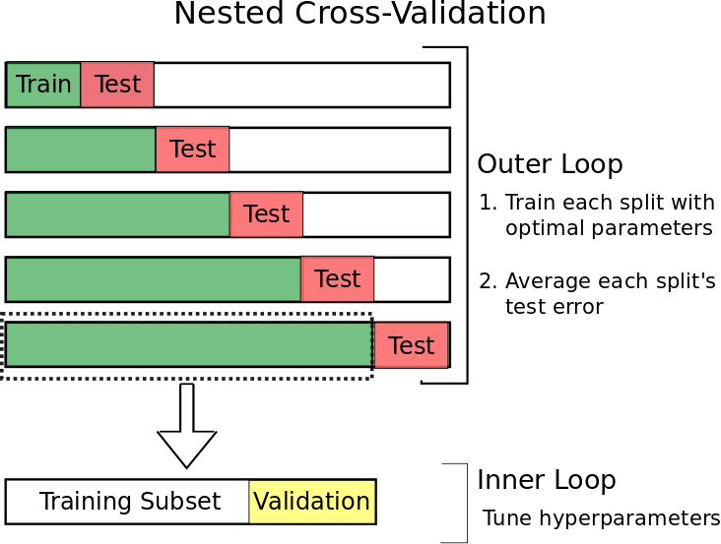
4.2 Datasets
Train dataset
Valid dataset
Test dataset
Nested cross-validation (double cross-validation) is an approach to model hyperparameter optimization and model selection that attempts to overcome the problem of overfitting the training dataset.
Cross-validation in Deep learning?
https://towardsdatascience.com/time-series-nested-cross-validation-76adba623eb9
Notes:
https://machinelearningmastery.com/nested-cross-validation-for-machine-learning-with-python/

Slide 25
4.3 Model training
Hyperparameters
set manually and are used in processes to help estimate model parameters.
Parameters
estimated from data automatically
An example of hyperparameters from any of the lectures you learned so far?

Slide 26
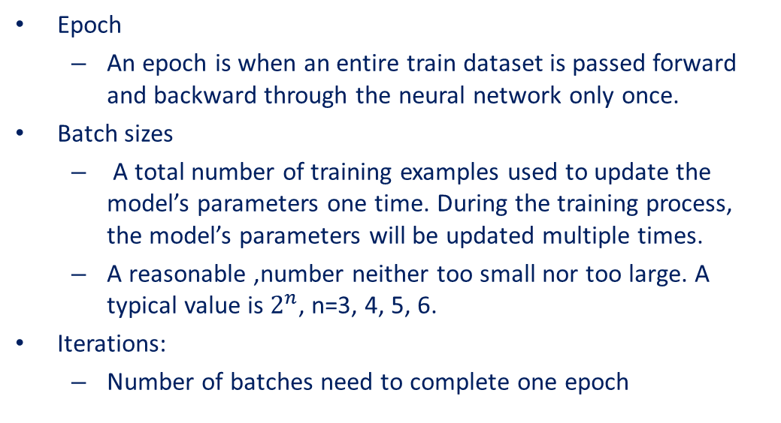
4.3 Model training
Train dataset
Update parameters for every two samples, batch size=2. Iterations = 12/2=6 per epoch
Epoch
An epoch is when an entire train dataset is passed forward and backward through the neural network only once.
Batch sizes
A total number of training examples used to update the model’s parameters one time. During the training process, the model’s parameters will be updated multiple times.
A reasonable ,number neither too small nor too large. A typical value is $2^{n}$, n=3, 4, 5, 6.
Iterations:
Number of batches need to complete one epoch
Notes:
Why multiple epoch? updating the weights with single pass or one epoch is not enough.

Slide 27
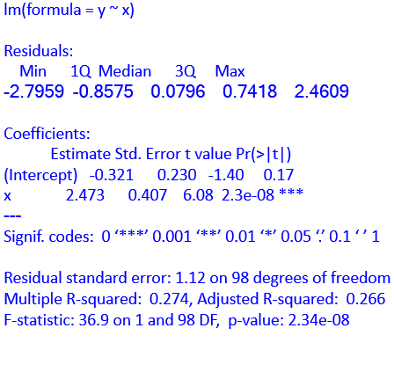
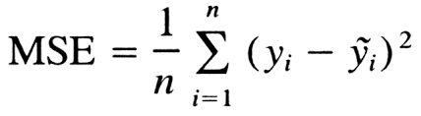
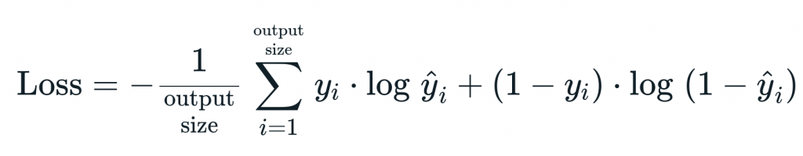
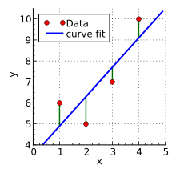
4.3 Model training
Loss function (minimize) / Objective function (optimize)
Quantitative: Mean squared error (least squares)
Binary or Categorical: cross-entropy
How does lm figure out beta values?
Least Squares Estimation/ Ordinary least squares
https://en.wikipedia.org/wiki/Linear_least_squares;
Notes:
In our lives, while performing a task it is important to understand are we going in the right direction or how far are we from our destination. This information is essential to decide the future course of action. The machine learning models work in a similar manner. That’s where loss function or objective jump into.
https://machinelearningmastery.com/how-to-choose-loss-functions-when-training-deep-learning-neural-networks/

Slide 28
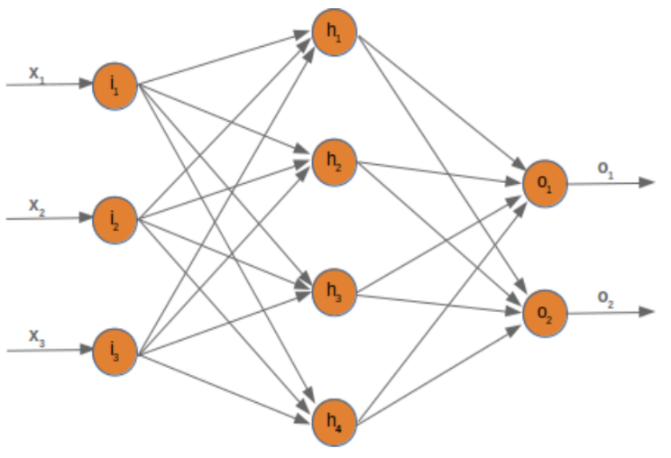
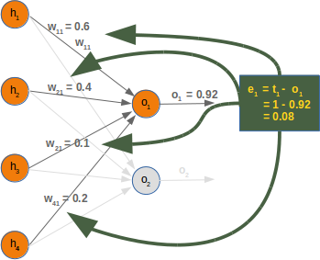
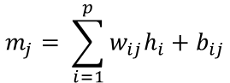
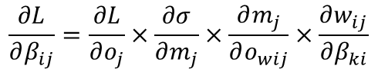
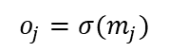
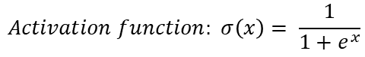
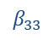
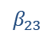
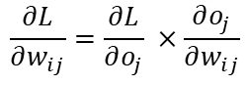
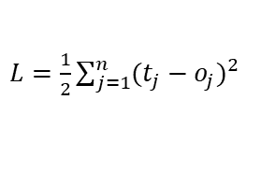
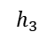
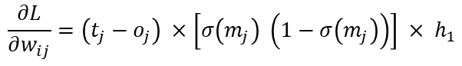
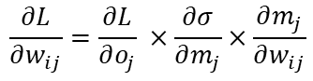
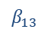
4.3 Model training
i
k
Feed forward
input training data at the input layer, and it travels from input to hidden and from hidden to the output layer
Back propagation
a widely used algorithm for training feedforward artificial neural networks
feed forward the values
calculate the error and propagate it back to the earlier layers.
j
$$m_{j}= \sum_{i=1}^{p}{w_{ij}h_{i}+b_{ij}}$$
$$\frac{∂L}{∂w_{ij}}=\frac{∂L}{∂o_{j}} ×\frac{∂o_{j}}{∂w_{ij}}$$
$$o_{j}=σ(m_{j})$$
$L=\frac{1}{2}\sum_{j=1}^{n}{{(t_{j}−o_{j})}^{2}}$
x1
$$Activation function: σ\left(x\right)= \frac{1}{1+e^{x}}$$
x2
$$β_{13}$$
$$β_{23}$$
$$\frac{∂L}{∂w_{ij}}=\frac{∂L}{∂o_{j}} ×\frac{∂σ}{∂m_{j}}×\frac{∂m_{j}}{∂w_{ij}}$$
x3
$$β_{33}$$
$$h_{3}$$
$$\frac{∂L}{∂β_{ij}}=\frac{∂L}{∂o_{j}}×\frac{∂σ}{∂m_{j}}×\frac{∂m_{j}}{∂o_{wij}}×\frac{∂w_{ij}}{∂β_{ki}}$$
$$\frac{∂L}{∂w_{ij}}=\left(t_{j}−o_{j}\right) ×\left[σ\left(m_{j}\right) \left(1−σ\left(m_{j}\right)\right)\right] × h_{1}$$
https://medium.com/@jorgesleonel/backpropagation-cc81e9c772fd
Notes:
The chain rule tells us how to find the derivative of a composite function.

Slide 29










4.3 Model training
Gradient Descent:
Optimizer:
SGD: stochastic gradient descent
Adam: Adaptive Moment Estimation
Learning rate
$α$, controls how quickly the model is adapted to the problem. Range from (0,1) but usually a small positive value (e.g., 0.001).
gradient
Momentum:
RMSProp:
Adam:
https://medium.com/mdr-inc/from-sgd-to-adam-c9fce513c4bb; https://medium.com/geekculture/a-2021-guide-to-improving-cnns-optimizers-adam-vs-sgd-495848ac6008
Notes:
Now we know our objectives, the remaining problem is how to get there.

Slide 30

4.3 Model training
Model training in a nutshell:
https://gfycat.com/miniaturedependentcob

Slide 31











4.4 Model evaluation
Metrics:
Quantitative outputs: Pearson R, Coefficient of determination${ R}^{2}$,
Dichotomized outputs: accuracy, precision, recall, F1 score, confusion matrix, and AUC (area under the ROC curve)
Precision
ROC curve
1: dog, 0: cat | Threshold | 0 | 0.2 | 0.4 | 0.6 | 0.8
Sample 1 (O1=1, O2=0) | O1 = 0.9 O2 = 0.1 | 1, 0 | 1, 0 | 1, 0 | 1, 0 | 1, 0
Sample 2 (O1=0, O2=1) | O1 = 0.7 O2 = 0.3 | 1, 0 | 1, 0 | 1, 0 | 1, 0 | 0, 1
Sample 3 (O1=0, O2=1) | O1 = 0.5 O2 = 0.5 | 1, 0 | 1, 0 | 1, 0 | 0, 1 | 0, 1
Sample 4 (O1=1, O2=0) | O1 = 0.3 O2 = 0.7 | 1, 0 | 1, 0 | 0, 1 | 0, 1 | 0, 1
Recall / TPR
AUC
Recall / TPR
Threshold?
F1 score
FPR
Accuracy
$$\frac{TP+TN}{TP+TN+FP+FN}$$
https://towardsdatascience.com/precision-and-recall-88a3776c8007
Notes:
https://towardsdatascience.com/accuracy-recall-precision-f-score-specificity-which-to-optimize-on-867d3f11124
Precision
Precision is the ratio of the correctly +ve labeled by our program to all +ve labeled. Precision answers the following: How many of those who we labeled as diabetic are actually diabetic?
Recall (aka Sensitivity): Receiver Operating Characteristic curve
Recall is the ratio of the correctly +ve labeled by our program to all who are diabetic in reality. Recall answers the following question: Of all the people who are diabetic, how many of those we correctly predict?
F1-score (aka F-Score / F-Measure)
F1 Score considers both precision and recall. It is the harmonic mean(average) of the precision and recall. F1 Score is best if there is some sort of balance between precision (p) & recall (r) in the system. Oppositely F1 Score isn’t so high if one measure is improved at the expense of the other.
Accuracy
It’s the ratio of the correctly labeled subjects to the whole pool of subjects. Accuracy is the most intuitive one. Accuracy answers the following question: How many students did we correctly label out of all the students?
Specificity
Specificity is the correctly -ve labeled by the program to all who are healthy in reality. Specifity answers the following question: Of all the people who are healthy, how many of those did we correctly predict? Specificity = TN/(TN+FP), 1- recall.

Slide 32

4.4 Model evaluation
Evaluation metrics:
Regression:
Pearson R, Coefficient of determination${ R}^{2}$,
Classification:
accuracy, precision, recall, F1 score, confusion matrix, and AUC. Which is the optimal one? Depends on specific user-cases.
General notes:
Precision: more confident of your true positives (e.g., spam emails)
Recall: false positives cost less than false negatives (aka false negatives are intolerable) (e.g., gas leakage)
F1 score: false positives and false negatives not balance
Accuracy: false positives and false negative balances and they have similar costs
AUC: Model’s overall performance, not point performance at a certain threshold
Evaluate the model on the validation dataset to optimize hyperparameters, stop earlier, measure model’s performance and select optimal models.

Slide 33


5. Hands-on: Image classification
Task: Transfer pre-trained model MobileNet V2 on the classification of images of dogs and cats.
1. Load and examine pre-trained MobileNetV2
2. Add additional layers to form a new model
3. Load and examine datasets
4. Train the new model
5. Fine-tune the new model
https://colab.research.google.com/drive/1p7lmhIh1AUKJx-aZnbdsBoqmpS3p0DrS
What is Colab? https://colab.research.google.com/
Colab, or ‘Colaboratory’, allows you to write and execute Python in your browser, with
Zero configuration required
Access to GPUs free of charge
Easy sharing

Slide 34



Acknowledgment
https://sites.google.com/site/quanlongresearch/?pli=1

Slide 35

Thank you

